Slide 1
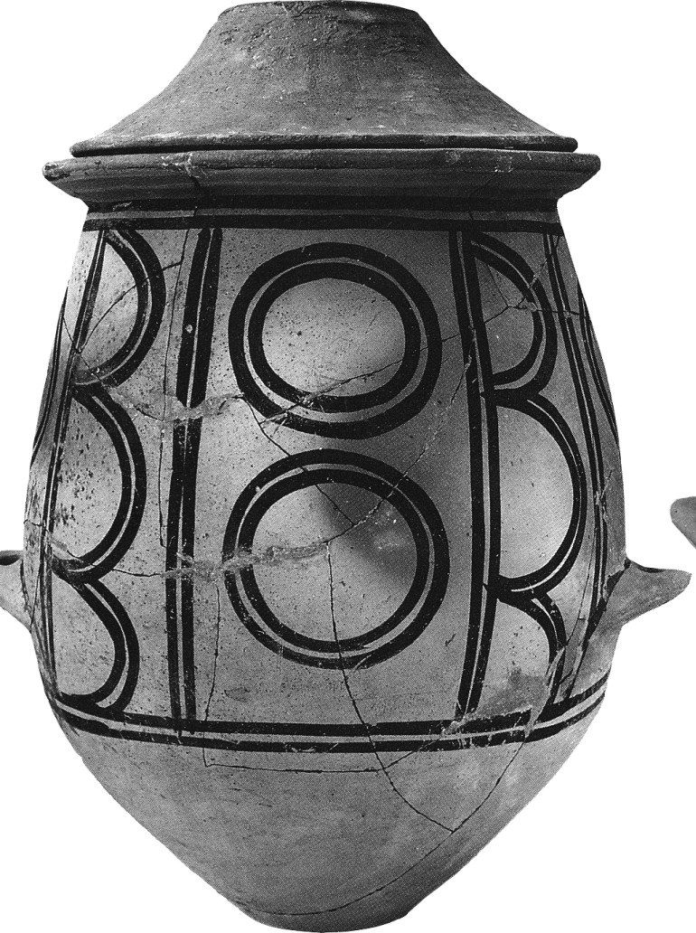
A Geologic Method for the Explanation of Cultural Change and its Nature: Unraveling Archaeological Problems using Provenance and Processing
Christine Shriner
Dept. of Geological Sciences, Indiana University
In collaboration with: J. Brophy, G. Christidis², B. Douglas, R. Droppo, E. Elswick, C. Li, H. Murray, E. Ripley, A. Schimmelmann
²Dept. of Mineral Resources Engineering, Technical University of Crete, Greece

Slide 2
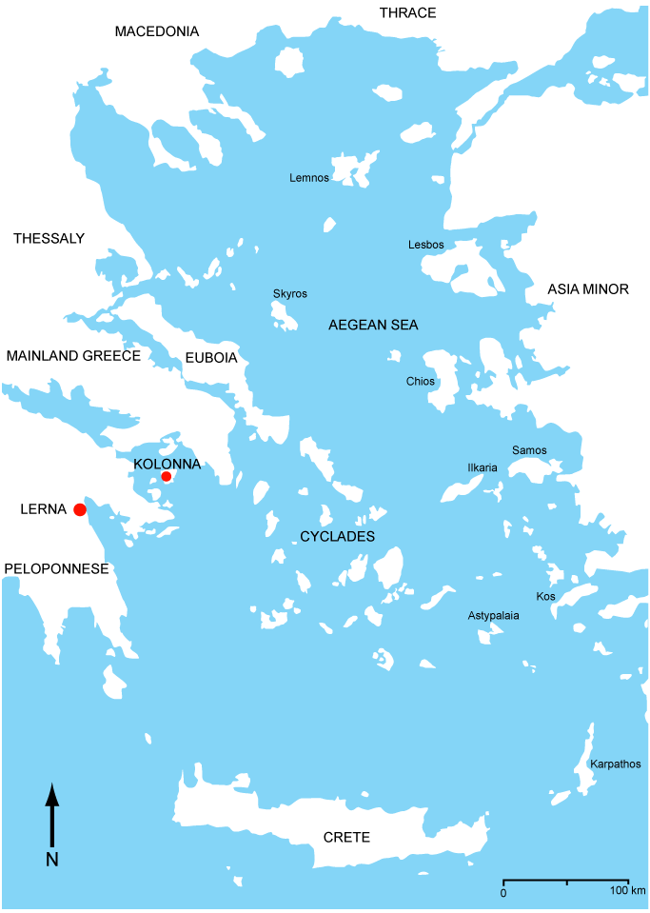
EXPLANATIONS FOR CULTURAL CHANGE
SPECIFIC TIME: THIRD MILLENNIUM B.C. SPECIFIC SPACE: AEGEAN COMPLEX
External or Non-local Change: Prevailing
Borrowed Technology, Economy and Social Organization
Conservative/Marginal Cultures/a Mere Reflection/Trickle-down Effect
Non-local change observed as sudden/event-driven.
Internal or Local Change: Alternative
Explanatory Potential of Local Response
Aegean Cultures as an Independent System
Complex Systems or Emergent Complexity (EC)
New Hypothesis-building
Environmental Changes linked to Cultural Change
Local change is long-term, continuous and involves a response.
Cultural transformations not cultural collapse
Why has Local Change not gained acceptance?
Difficult to derive data that isolates local production/provenance and processing.
After Broodbank, 2000

Slide 3
ARCHAEOLOGICAL CONTEXT
Perspective
Importance of Ceramics to Chronology
Introduction of Systems Theory to Cultural Problem (Renfrew, 1972)
Wanted to prove local cultural change in 3rd Millennium Aegean Complex.
Wanted to see cultural response or positive feedback, i.e. can predict variables that trigger change.
Wanted to make EC a global phenomenon.
We have successfully constructed a local explanation for this problem.
HOW DID WE DO IT?
We developed a method that can isolate or emphasize local production.
After Broodbank, 2000

Slide 4
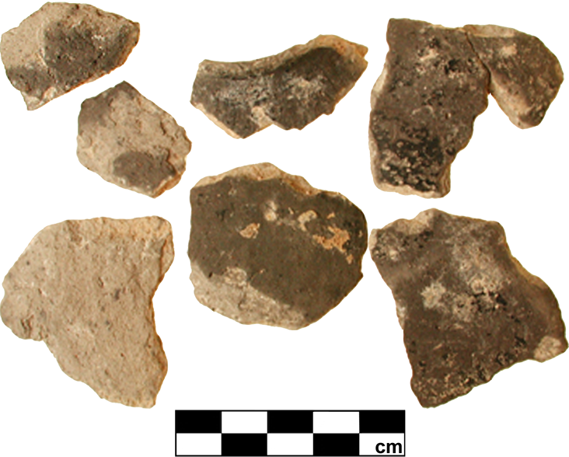
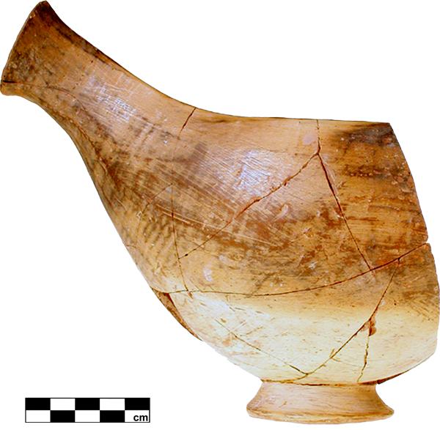
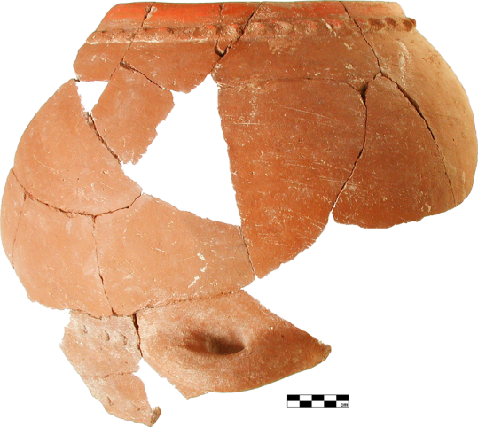
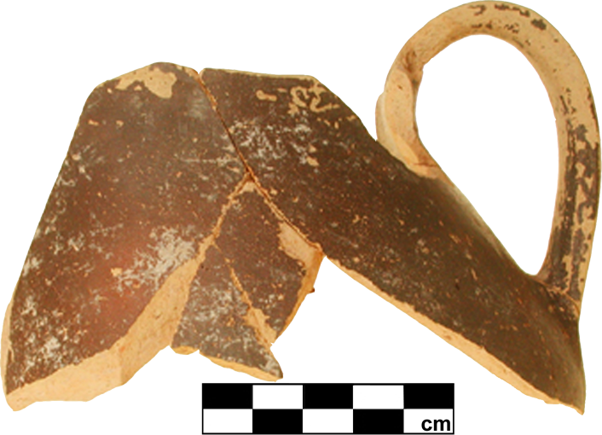
GEOLOGIC METHOD FOR LOCAL CULTURAL CHANGE
Local raw material reference standards developed
Ceramics used as an industry – not as a chronological tool
Demonstrable and testable evidence lines based on technology criteria
Characterization of sherd material and raw material

Slide 5
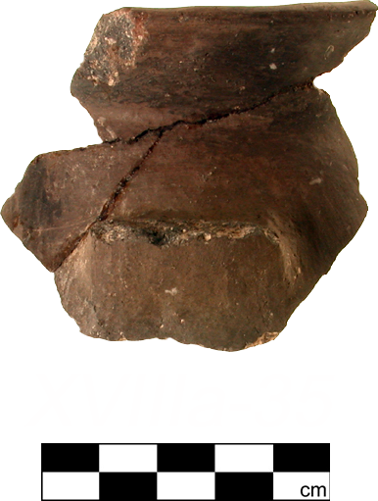
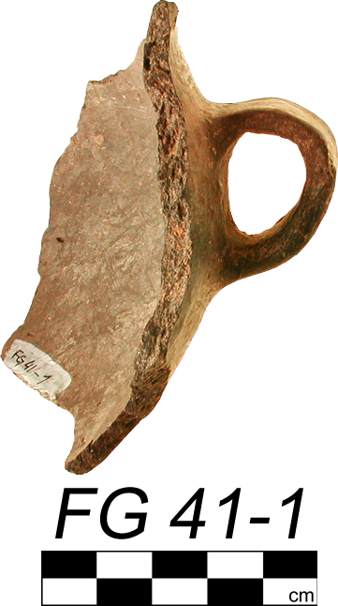
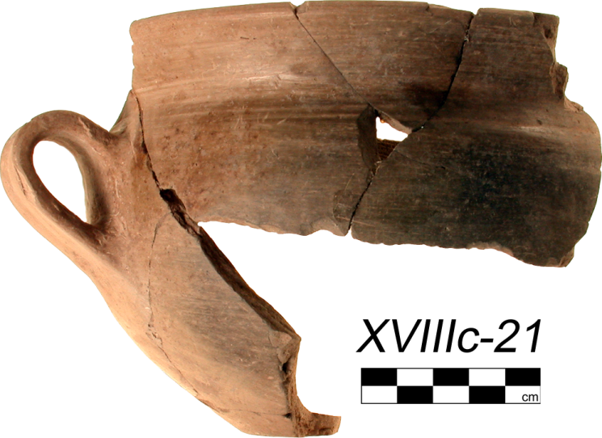
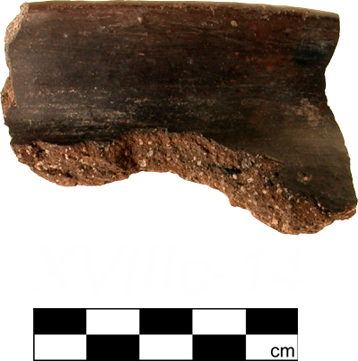
GEOLOGIC METHOD FOR LOCAL CULTURAL CHANGE
Ceramic change takes the form of a sudden shift from fine to coarse ware production.
More images of ceramic change available on SAVA database site: http://www.indiana.edu/~sava/gallery.html
Local Parameters: had to demonstrate that the following were local
ceramic production/provenance before change
source clay identification
fine and naturally-tempered coarse ware production
addition and dominance of a low-fired ceramic production strategy.

Slide 6
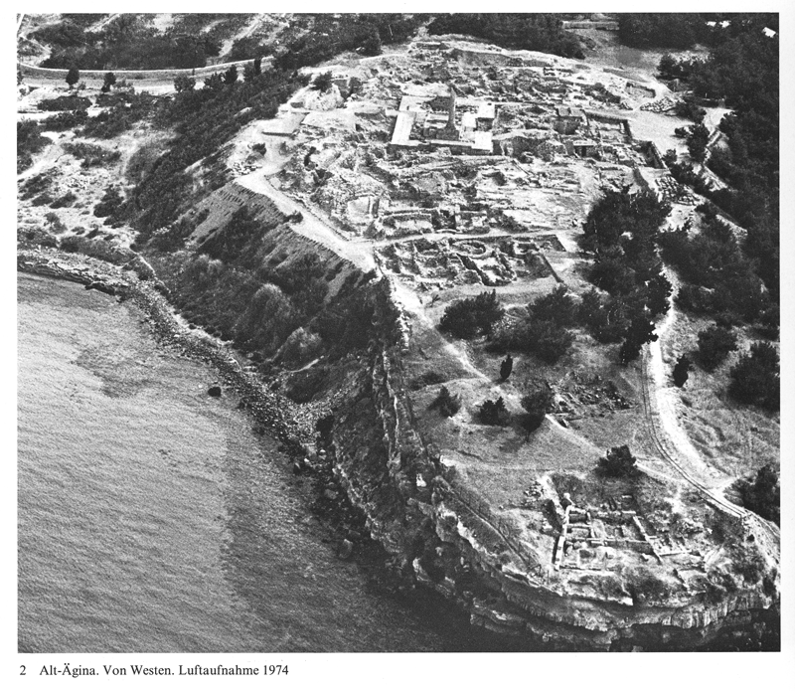
GEOLOGIC METHOD FOR LOCAL CULTURAL CHANGE
Four lines of comparable site evidence created/Mann site, Lerna and Kolonna
Wiencke, 2000
House of Tiles, Lerna, Greece (above); site of Kolonna, Aegina Island, Greece (right)
Walter and Felten, 1981

Slide 7
ALTERNATIVE EXPLANATION FOR LOCAL CULTURAL CHANGE IN THE 3RD MILLENNIUM BC AEGEAN COMPLEX
We isolated a unique form of emergent ceramic economies at two important Greek Early Bronze Age sites, Lerna and Kolonna: Explanation establishes comparability.
We suggest that what appears as a period of ca. 150-200 years of rapid, non-local technological change was in reality long-term and continuous local innovation: Explanation shows local social response.
Moreover, we suggest that the emerging ceramic industry was a reflection of proto-industrialization within raw materials in the Aegean Complex: Explanation recognizes entrepreneurial organization much earlier.
Technological revolution in other emerging industries (e.g. shipping, metallurgy, fishing): Competitive marketing changed.
Response to increased consumer demand from other industries for a more durable coarse ware: Social influences changed.
New Hypothesis: Cultural change was TRIGGERED by paleoenvironmental changes in the Eastern Mediterranean.
Climate changes linked to Greek cultural change and artifact distribution patterns: Environment changed.
After Rutter, 2001

Slide 8
SELECTED EXAMPLES OF COMPARATIVE EVIDENCE FOR AEGINETAN WARE : HUMAN CHOICE AND RAW MATERIAL POTENTIAL RESEARCH
Source Clay Studies
Large deposits mined: large % of clay
Naturally tempered resources: sources with a textural variation from fine to coarse
Ceramic Technology Studies
Was there the addition of low-fired and coarser ceramics?
Was mineral targeting versus vitrification used?

Slide 9
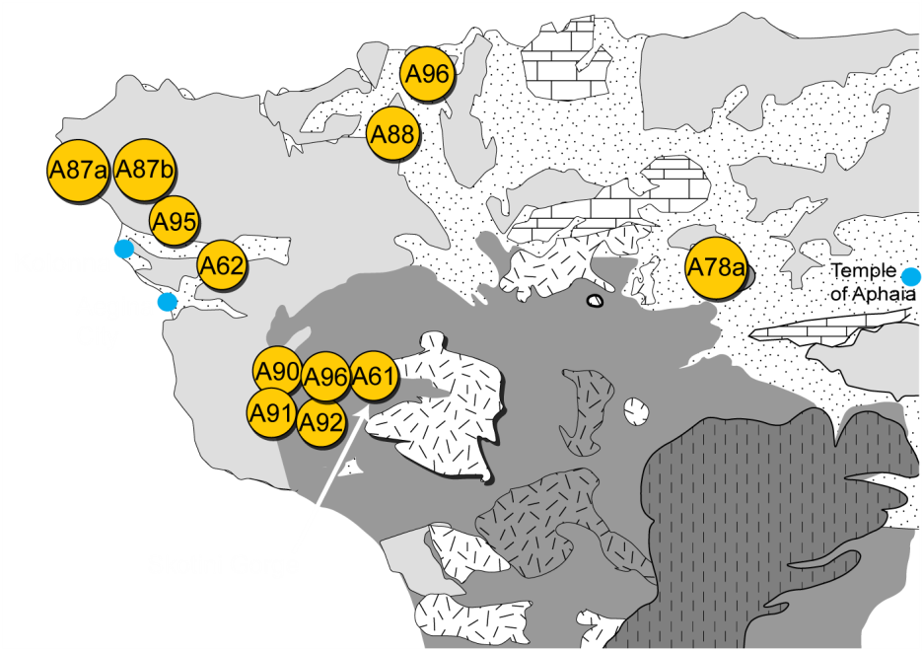
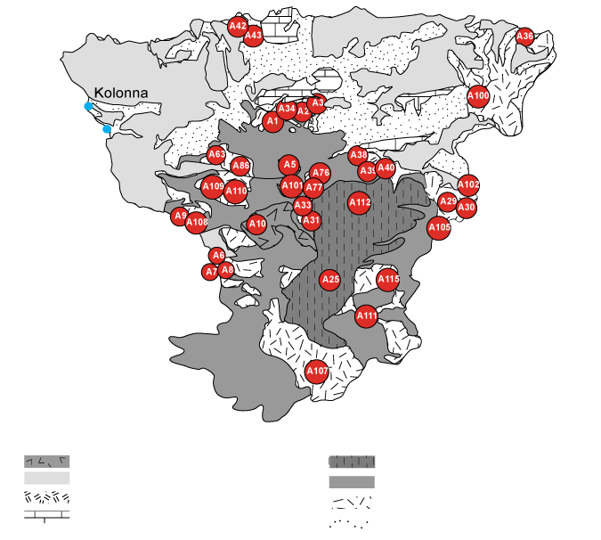
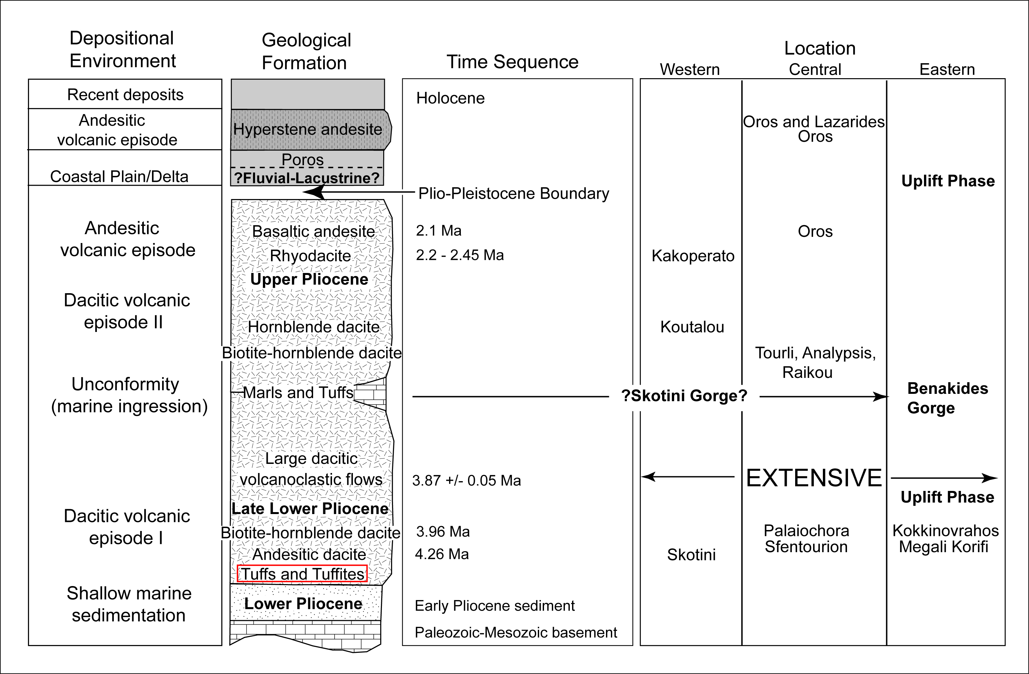
RAW MATERIAL PROVENANCING
After Dietrich et al., 1991
Petrographic Analysis: One mineralogical fabric in fine and coarse fractions; volcanic ash deposit.
Depositional Analysis: Altered submarine tuff has been lifted and exposed.
Archaeological Analysis: Combination of geologic events led to a large clay deposit that was mined to produce large volumes of specialized ceramic products.
After Morris, 2000
After Dietrich et al., 1991

Slide 10
GEOLOGIC PERSPECTIVE: EXTENSIVE, UNRECOGNIZED SOURCE CLAY FOR AW IDENTIFIED
The volcanic deposit contains quartz, feldspar, hornblende, and calcite.
Clay minerals include: kaolinite, mixed layer illite-smectite and chlorite-smectite.

Slide 11
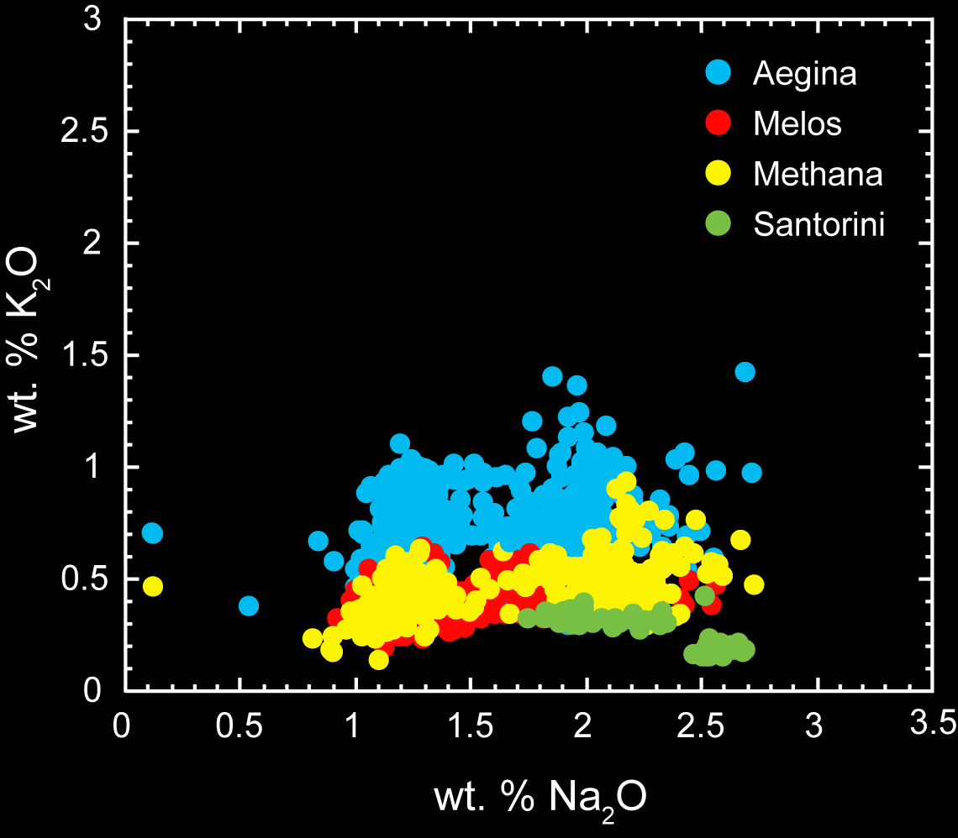
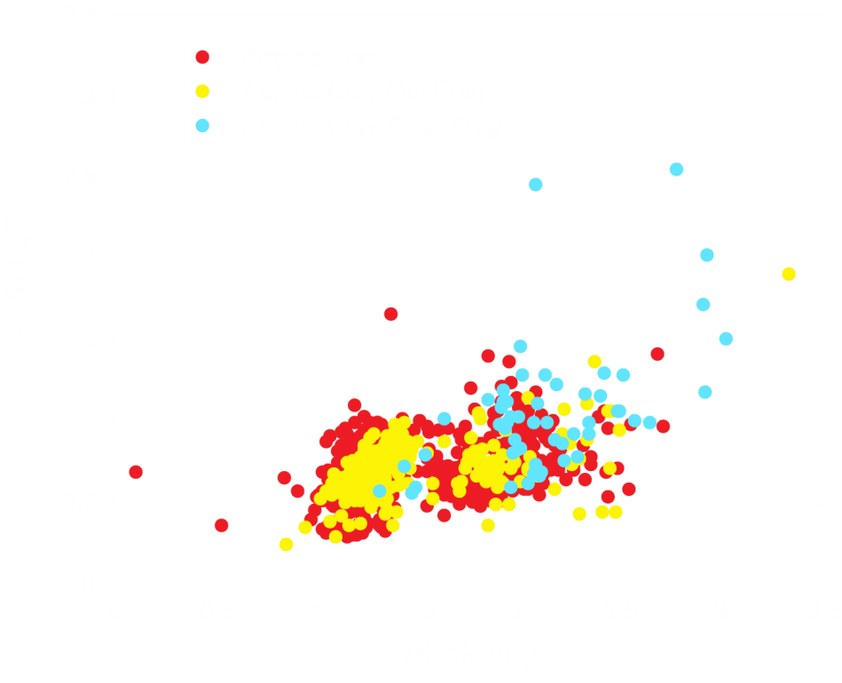
Two complementary lines of chemical investigation: electron microprobe analysis of hornblende mineral compositions and rare earth element abundances.
Comprehensive results are available on SAVA database site: http://www.indiana.edu/~sava/
Brophy and Shriner, 2009

Slide 12
Two complementary lines of chemical investigation: electron microprobe analysis of hornblende mineral compositions and rare earth element abundances.
It had already been suggested by Mommsen et al. (2001) that his NAA chemical groups A/E (fine) and P/F (coarse) were from Aegina.

Slide 13
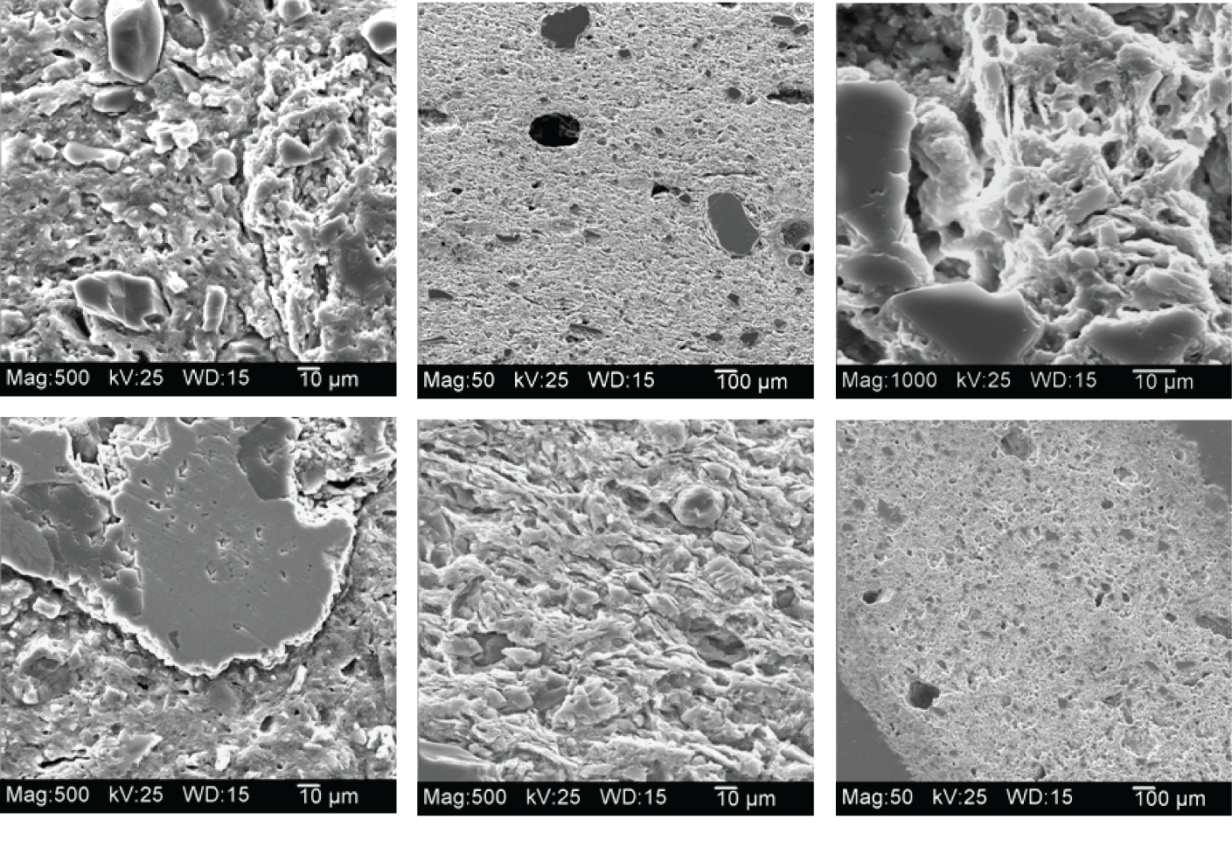
TECHNOLOGICAL POTENTIAL OF RAW MATERIAL
Microstructure and Mineralogy of Aeginetan Ware
Provenanced AW sherd characterization study only
XRD results indicated that firing temperatures did not exceed 1000º C.
Visual analysis by SEM revealed the physical qualities of vitrification in varying degrees.
Some factor other than vitrification was driving ceramic production.
Shriner, C.M., W. Carty, H.H. Murray, H. Lee, G.E. Christidis, and J.G. Brophy. 2005.

Slide 14
Recent strength tests on same AW sherds and raw materials
Modulus of Rupture (MOR) tests indicated that the strength pattern for the majority of sherds appeared in the range of 5-15 MPa.
Values are comparable to those of Cretan bricks, fired at temperatures lower than 900° C (Panagiotakis, 1997).
Most comparable source clay strength values derived from the partial reduction firing.
To resolve the strength issue, we fired the RM under different firing cycles, examined results with XRD, and constructed TTT diagrams
Shriner, C.M., B.J. Douglas, E.R. Elswick, J.G. Brophy, G.E. Christidis, E. Hasaki, and H.H. Murray. 2008.

Slide 15
TIME, TEMPERATURE AND TRANSFORMATION (TTT) DIAGRAM OF REPRESENTATIVE SOURCE CLAY SAMPLE (A61)
Smectite disappears at temperatures lower than 750°C.
Hematite present throughout temperature range.
Calcite abundance decreased during firing.
Neoformed minerals include: larnite, melilite/gehlenite, anorthite and diopside.
Melilite/gehlenite appeared at 800°C and present in the whole firing range.
Diopside appeared at 800°C but at longer firing cycles than melilite.
Gehlenite and diopside react in presence of SiO₂ to produce anorthite.
Igneous plagioclase disappeared at 1000°C; no formation of wollastonite.

Slide 16
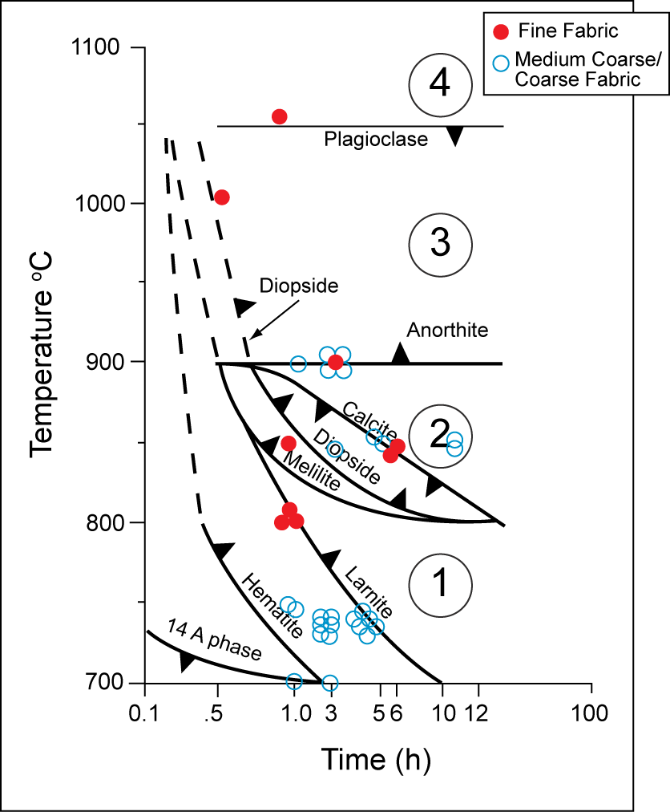
TTT DIAGRAM OF A61 WITH SUPERIMPOSED KOLONNA SHERDS
Representative sample A61 has the chemical potential to obtain the suggested neoformed mineral phases that we need.
In general, all ceramic classes are fired below 900°C.
Two firing patterns observed.
Preference for 750°C at 3-6 hours

Slide 17
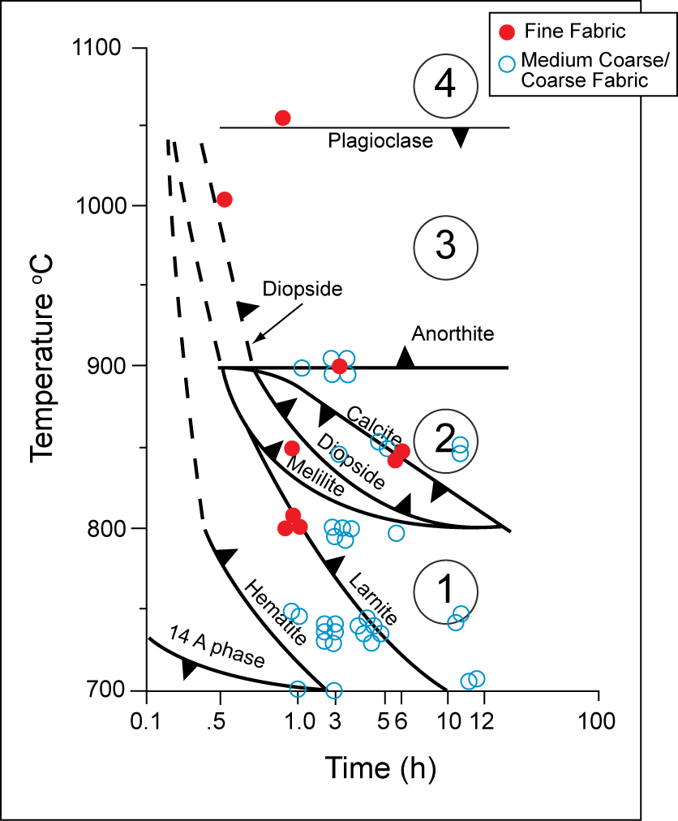
TTT DIAGRAM OF A61 WITH SUPERIMPOSED KOLONNA SHERDS
Representative sample A61 has the chemical potential to obtain the suggested neoformed mineral phases that we need.
In general, all ceramic classes are fired below 900°C.
Two firing patterns observed.
Preference for 750°C at 3-6 hours
Calcium carbonate, along with reduction firing, imparted strength rather than vitrification.

Slide 18
CONCLUSIONS
Significance of Research:
Local Change Model has been demonstrated and reproduced
Paleoenvironmental and cultural change hypothesis begun
Global value for both
Idea of Successive Verification integrated into Research

Slide 19
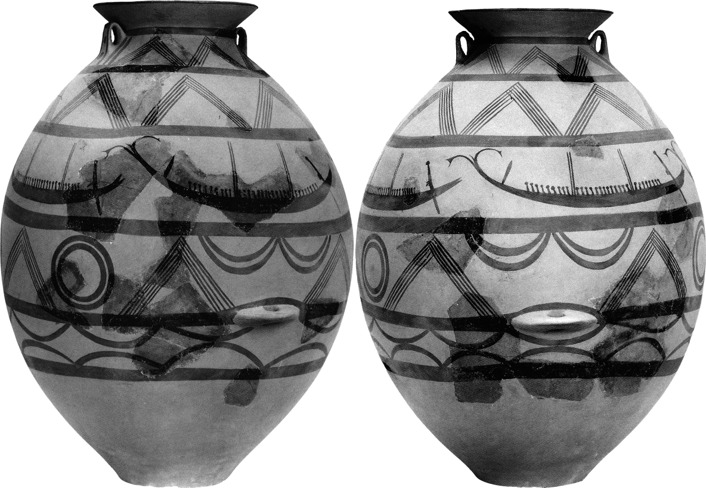
ACKNOWLEDGEMENTS
The National Endowment for the Humanities
The Cotton Foundation (UK)
Indiana Academy of Science
Schrader Archaeological Endowment Fund (IU)
The Institute of Aegean Prehistory (INSTAP)
The Department of Geological Sciences, Indiana University
Ruth Droppo, Graphic Artist, Indiana University

