Slide 1
clay mineralogical studies for greek bronze age Roofing technology
Christine M. Shriner, Erika R. Elswick, Hannah L. Timm, and Haydn H. Murray
Dept. of Geological Sciences, Indiana Univ., Bloomington, IN, USA

Slide 2
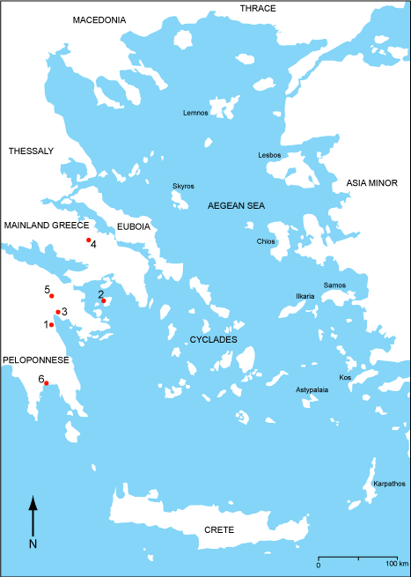
MAP OF THE AEGEAN COMPLEX AT 2400 B.C.
Corridor House Examples
1 - Lerna
2 - Kolonna
3 - Tiryns
4 - Thebes
5 - Zygouries
6 - Akovitika

Slide 3
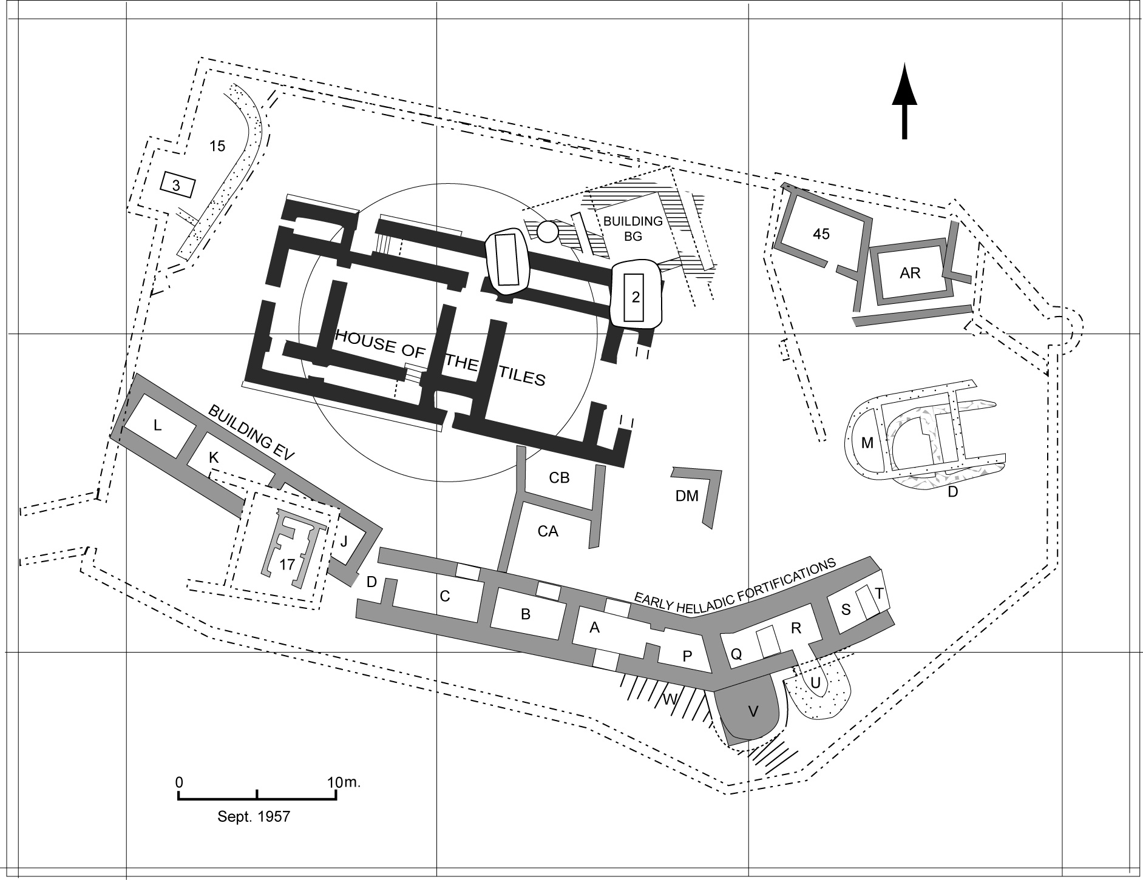
Lerna, area plan. (After Caskey 1958; Wiencke, 2000)

Slide 4
Lerna, final view of the House of Tiles. (Wiencke, 2000)

Slide 5
Tiles, House of Tiles

Slide 6
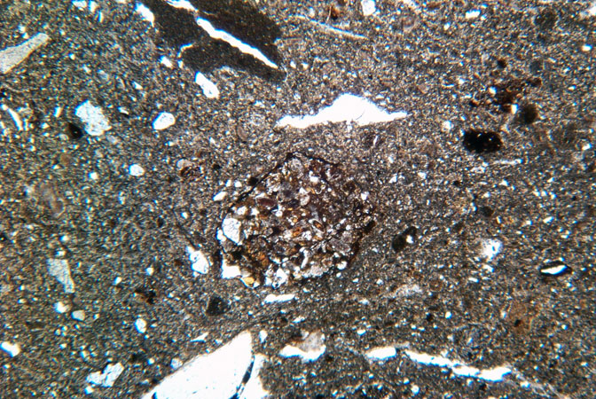
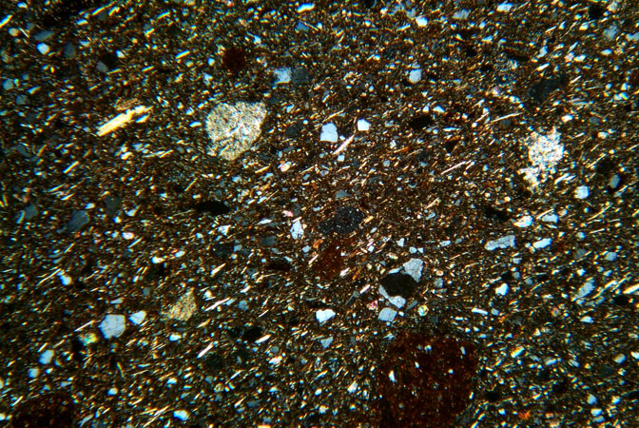
HT-2
Tile FTP

Slide 8
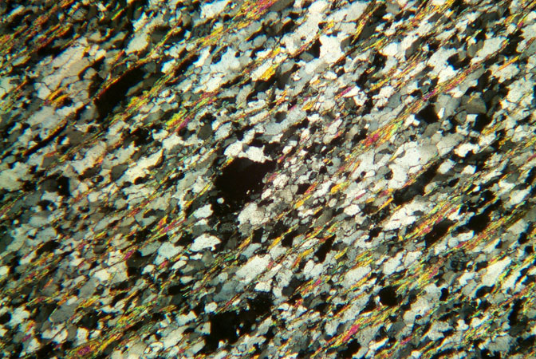
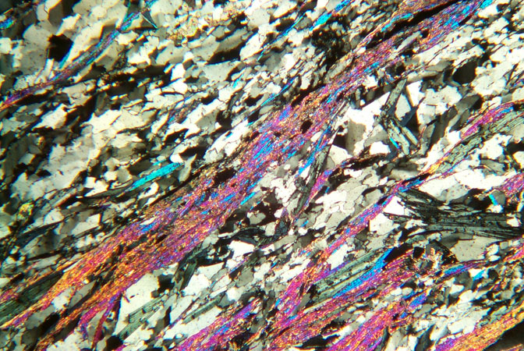
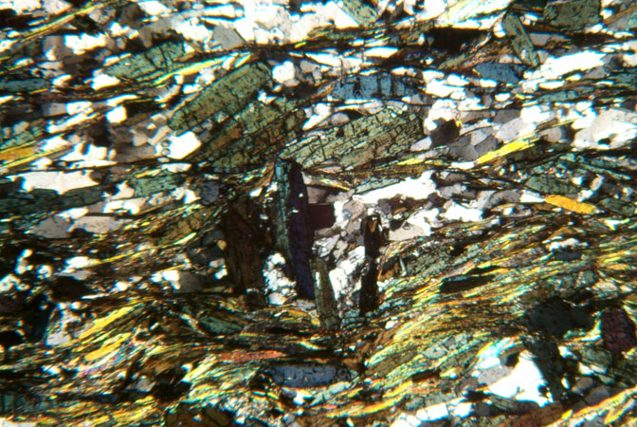
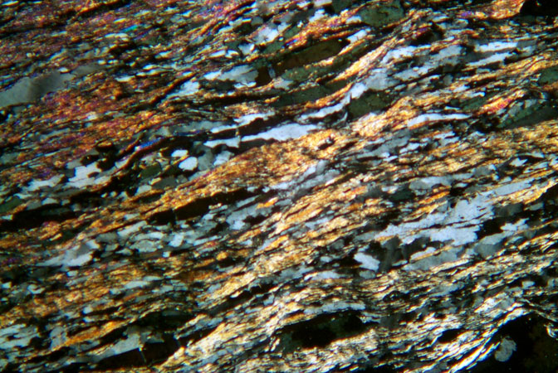
Number 20 Phyllite
Number 19 Phyllite
CHS Chloritoid
Mercouri sample

Slide 9
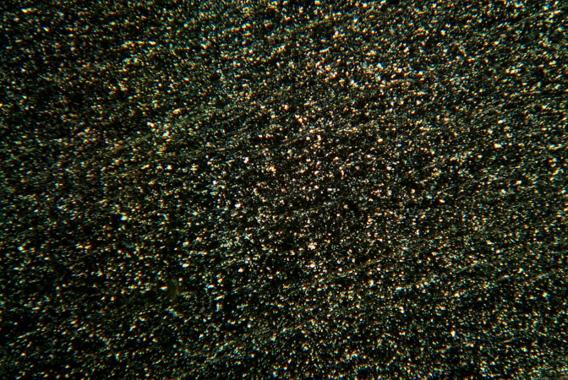
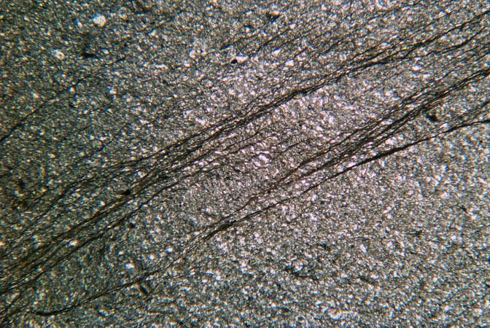
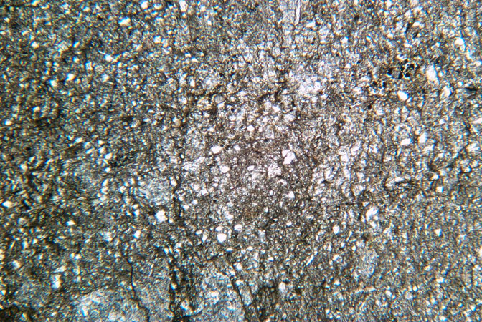
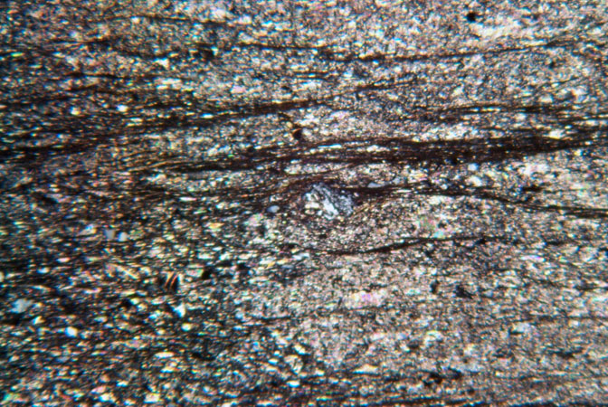
HT-3
HT-7
HT-18
HT-14
Eaves, House of Tiles

Slide 10
XRD ANALYSIS
► X-ray diffraction analysis was undertaken on the eaves, as well as samples from the local schist (metaflysch), Pindos and Tripolis flysch deposits.
► The clay mineralogy is chlorite, illite and kaolinite, with accompanying quartz, calcite and feldspar.
►The lack of calcite in the potential source phyllites and schists was a tip off. The HT eaves have a 15-20% calcite component.

Slide 11
► It does not become a question of “looks more like” a flysch than a metaflysch.
► It becomes a question of whether the eaves indicate “something else”.
► THE ARTIFACTS BECOME A RAW MATERIAL REFERENCE!

Slide 12
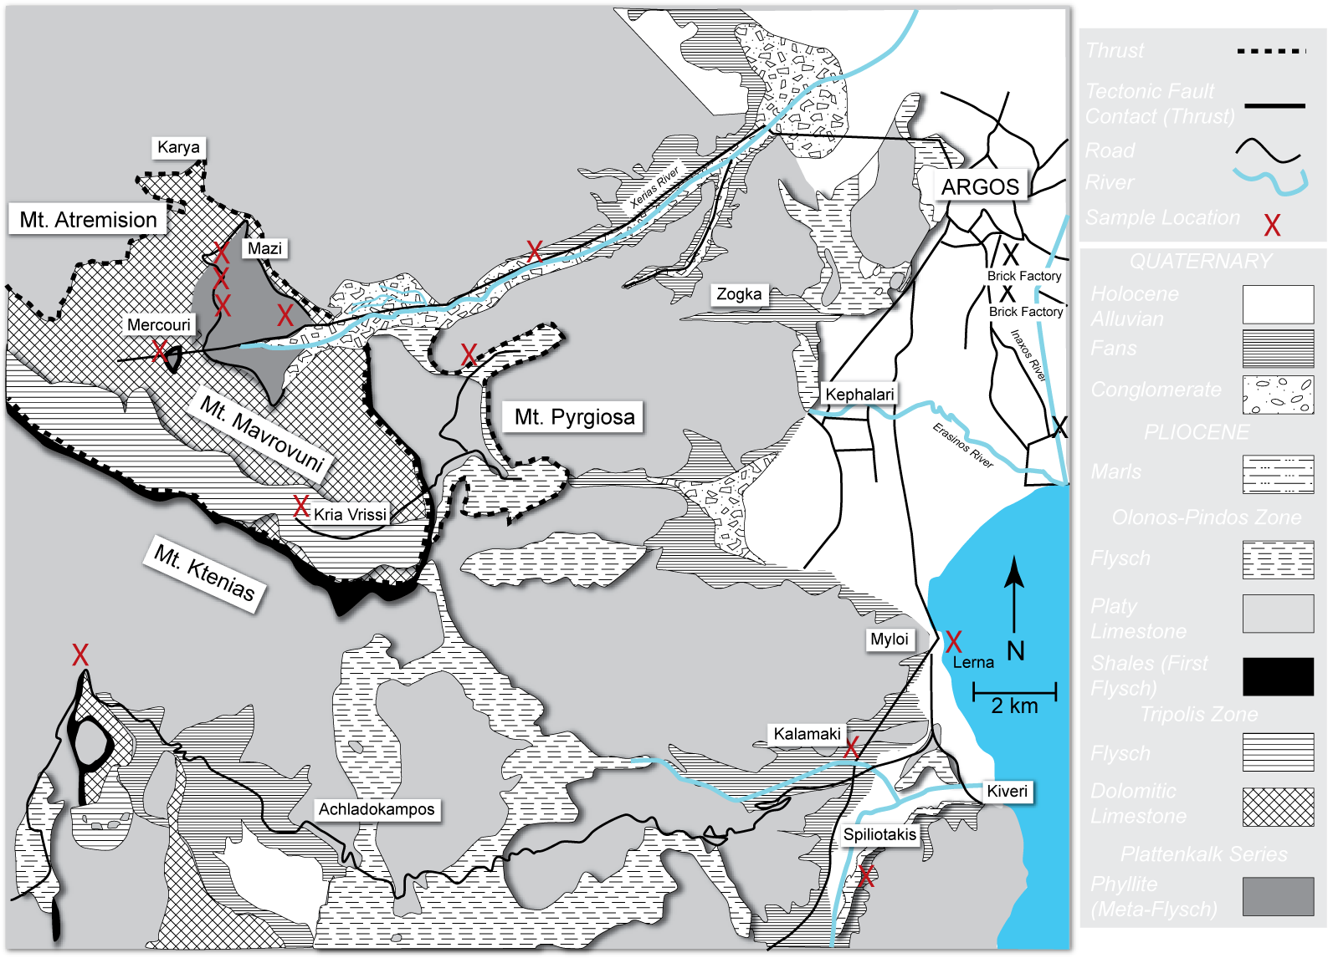
GEOLOGICAL PERSPECTIVE

Slide 13
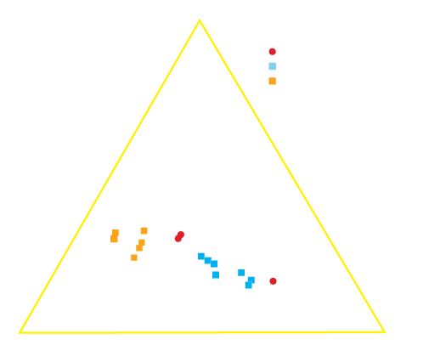
After: Philpots and Wilson (1994)

Slide 14
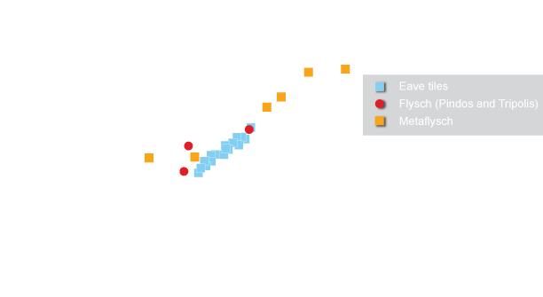

Slide 15
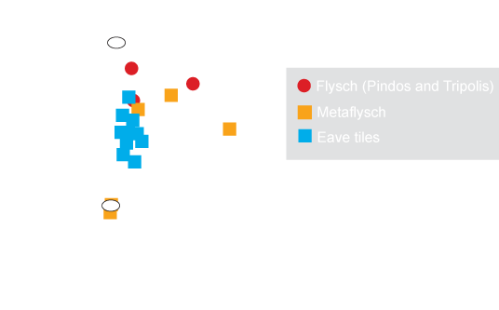
After: Saccani and Photiades (2005)

Slide 16
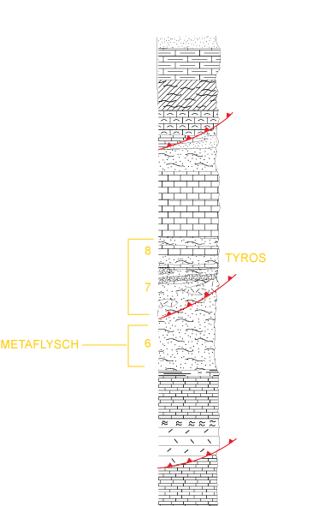
The Phyllite Problem
15: Post-Maistichtian flysch of Pindos Zone
13: Radiolarites, pelites with pelagic limestones and the “first flysch”
10: Tripolis flysch, with Paleochora formation on top
8: Lower-middle Trias of Tyros Beds (with limestones, shales and tuffs)
7: Upper Paleozoic of Tyros Beds (with limestones, shales, tuffs and vulcanites)
6: Metaflysch
5: Transitional beds to the metaflysch
After Lekkas and Papanidolaou, 1977

Slide 17
GEOLOGICAL AND ARCHAEOLOGICAL IMPLICATIONS
► HT eaves are not a schist or phyllite. Define HT eaves as an “argillite”.
► The very nature of argillite as a very indurated, clay-rich rock at the boundary between sedimentary and metamorphic rocks, makes sourcing studies more challenging.
► Sourced from one location. Presumed a local source on basis of other artifactual analyses.
► Chemical fingerprinting appears to be a useful tool in separating different fine-grained rock units in the region.

Slide 18
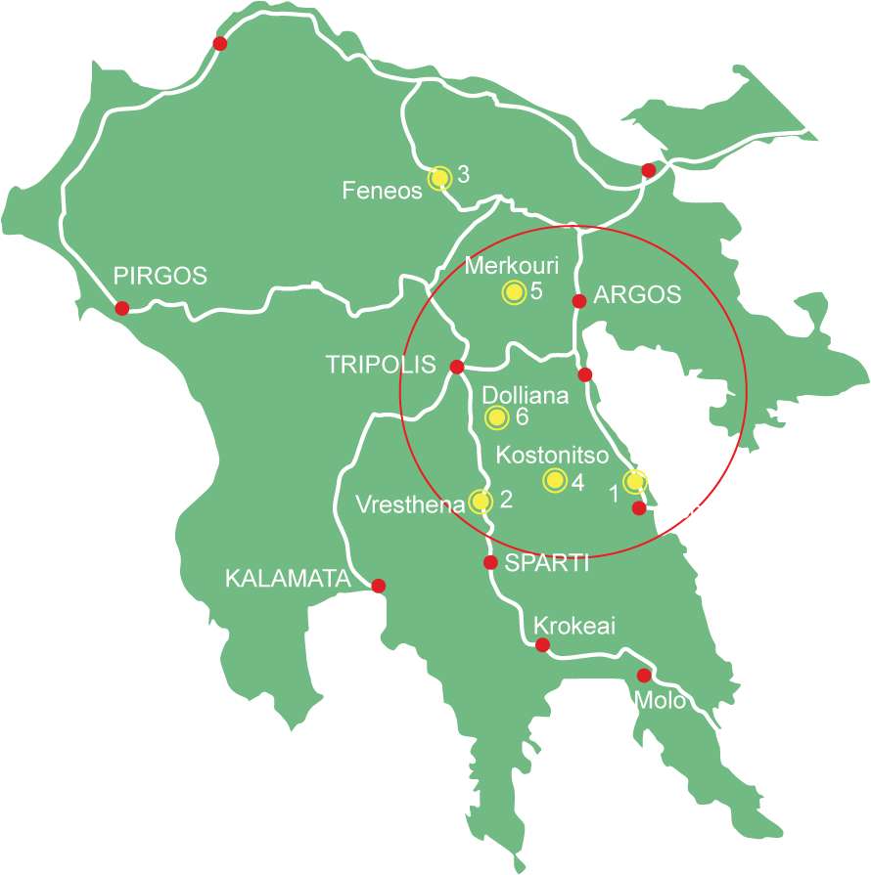
In archaeological terms a local source location of the Tyros Beds represents exploration of another physical environment for the Early Helladics at Lerna.

Slide 19
ACKNOWLEDGEMENTS
SCHRADER ARCHAEOLOGICAL ENDOWMENT FUND
HUTTON HONORS COLLEGE/PROFESSIONAL INTERNSHIP FOR H. TIMM
M. WIENCKE/ HEAD OF LERNA EXCAVATIONS PUBLICATIONS
EPHOREIA FOR ANTIQUITIES/NAUPLION, GREECE
RUTH DROPPO, Graphic Artist
DEPARTMENT OF GEOLOGICAL SCIENCES, INDIANA UNIVERSITY

