Slide 1
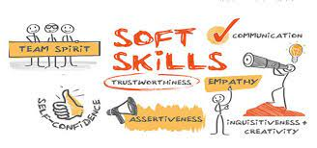

Active Listening:
Active Listening experiential workshop: the Art of Listening to Words and Emotions
Dr. Maria Bakatsaki
School of Production Engineering and Management
Technical University of Crete
mbakatsaki@tuc.gr

Slide 2
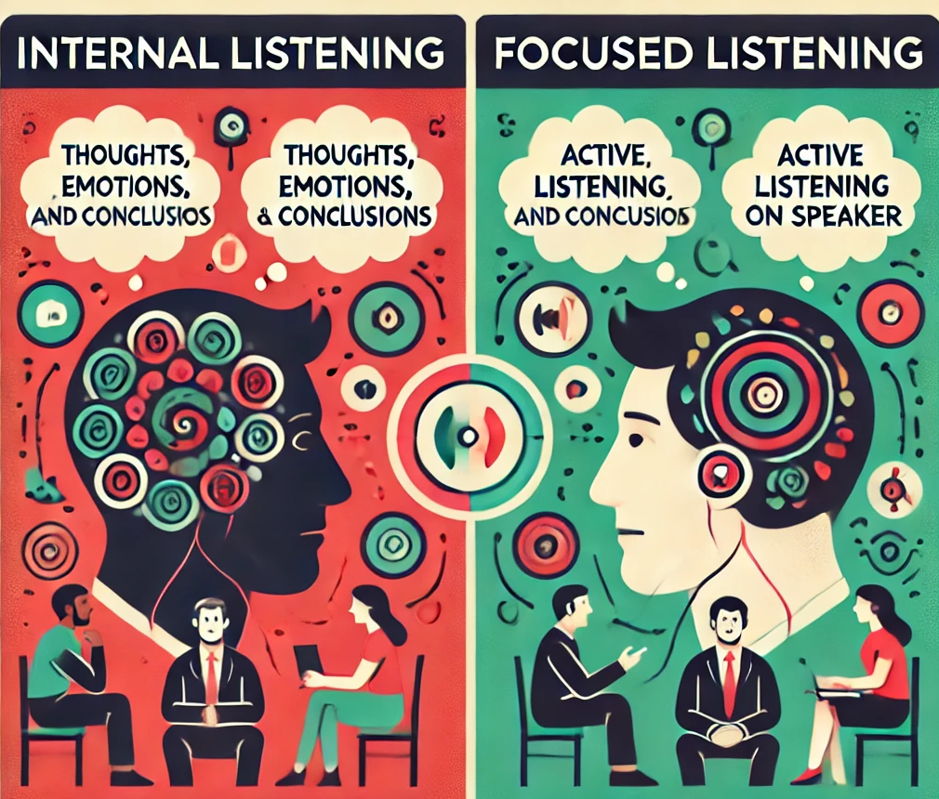
Hearing vs. Listening
The average of speakers communicate 125 words per minute, while the human brain can process 500 words per minute.
Hearing is a physical process involving the ears, while
Listening isn’t simply to listen to a message. It’s an active decoding and interpretation of oral messages.
Skill | Years of Training | Extend use in adult life
Writing | 14 | 16%
Reading | 8 | 9%
Talking | 1 | 30%
Listening | 0 | 45%
(Πηγή: Hersey et al., 2001; Seibert, 1990; Caudill & Donaldson, 1986)
Notes:
Listening is consisted of 2 levels:
-Level 1: Internal Listening
At this level, the focus is on ourselves (thoughts, emotions and conclusions)
-Level 2: Focused Listening
Active Listening falls under Focused Listening and is a crucial skill for effective communication. When practicing active listening, our attention is directed toward the speaker rather than our own thoughts.

Slide 3
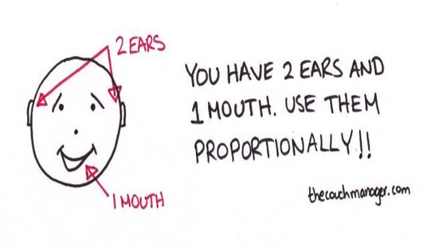
Golden Rule of Listening
Πηγή: (Ferrari, 2012)
«Courage is what it takes to stand up and speak, it’s also what it takes to sit down and listen.»
(Winston Churchill)
«Most people do not listen with the intent to understand; they listen with the intent to reply»
(Steve Covey, “The 7 Habits of Highly Effective People”)

Slide 4
Active Listening is the art of listening to words and emotions
Active Listening (AL) is the ability to help the "source" of a message express their true meaning by giving them our full attention, demonstrating empathy, and using all our senses to establish a genuine connection with our interlocutor. To achieve AL it is needed:
Interpretation of verbal and non-verbal cues
Stay curious about the reasons behind their behavior
Question perceptions
Help others express themselves through genuine concern and full attention
Regulate emotions to prevent anger outbursts
Set aside judgment, manipulation, egocentric attitudes, stereotypes, and personal assumptions that hinder communication

Slide 5
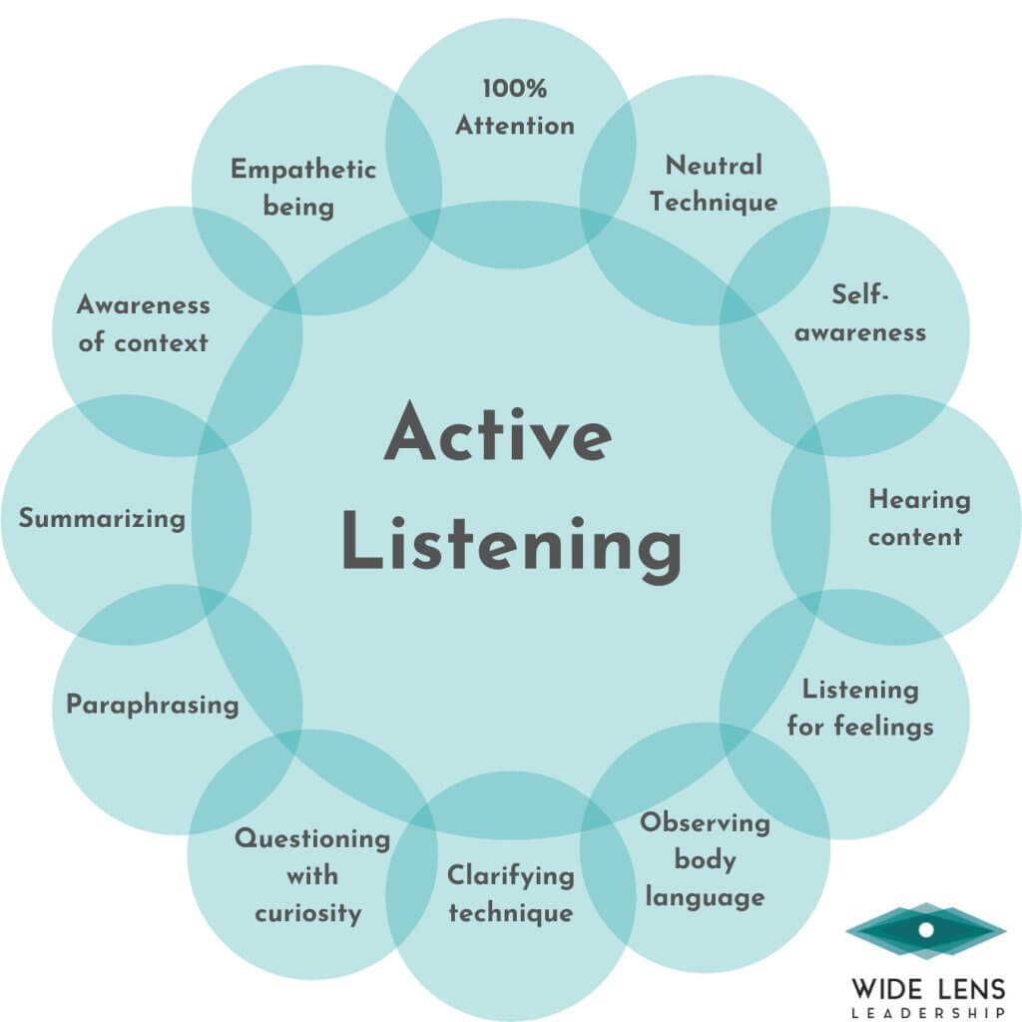

Active listening techniques
I may or may not be right in my opinion…
I wonder why Maria seemed so distant.

Slide 6
Active listening techniques (1/2)
Eliminate Distractions
Listen for content - exactly what is being said
Listen for feelings – try to identify how the source feels about things.
Reflect feelings - Acknowledge and reflect the speaker's emotions.
Empathize - Put yourself in the speaker's shoes and show empathy by expressing understanding of their feelings or perspectives.
Be open-minded and self-aware - suspend judgment
Avoid interrupting
Notes:
Eliminate Distractions - turn off or silence electronic devices, close the door, or find a quiet space to minimize distractions and focus on the speaker.
Listen for content – try to hear exactly what is being said. Avoid mentally preparing your response while the speaker is talking. Concentrate on what they are saying in the present moment.
Listen for feelings – try to identify how the source feels about things.
Reflect feelings - Acknowledge and reflect the speaker's emotions. For example, "It sounds like you were frustrated when..."
Empathize - Put yourself in the speaker's shoes and show empathy by expressing understanding of their feelings or perspectives. For example, "I can imagine that must have been challenging for you."
Be open-minded and self-aware - suspend judgment and approach the conversation with an open mind. Self-awareness in conversation means being able to set aside yourself and your beliefs and open up to what is being shared without judgment. It does not mean that you don’t have opinions; it just means that you can set them aside – even if they are strong-held beliefs – and step into an attitude of openness and non-judgment for the speaker, ensuring you don’t impose your views on someone else who is looking for an attentive, open ear. It also involves being able to notice how much space you are taking up in the conversation. This helps create a safe space for the speaker to share their thoughts and feelings.
Avoid interrupting – try not to talk too much or interrupt the other all the time or finish the speaker’s sentences.

Slide 7
Active listening techniques (2/2)
Use Positive Body Language.
Provide encouraging verbal cues
Note all cues – be sensitive to verbal and nonverbal expressions.
Ask Open Questions with curiosity- Reflect– To deepen information summarize or show that you are paying attention using:
a) paraphrasing: repeat what you’ve heard in your own words to confirm understanding
b) summarizing: periodically summarize the main points of the speaker’s message to ensure you’ve captured the essence of what they’re saying
Notes:
Use Positive Body Language – let the source know that you are engaged, and interested, and feelings are recognized by nodding your head, facing the other person, and maintaining eye contact. Adapt an open and relaxed body posture.
Provide encouraging verbal cues - Use affirmative statements like “I see”, “I understand”, or “Go on” to show that you are engaged and offer positive feedback or reinforcement to encourage the speaker to continue sharing. Phrases like “That’s great point” or “I appreciate you sharing that with me” can be effective.
Note all cues – be sensitive to verbal and nonverbal expressions.
Ask Open Questions with curiosity - to encourage the interlocutor to elaborate on their thoughts and feelings. Even if someone comes at you with an aggressive attitude, questions force others to think, even though they instinctively just want to react. For instance, “Can you tell me more about that?”, or “How did that make you feel?”
Reflect– To deepen information summarize or show that you are paying attention using a) paraphrasing: repeat what you’ve heard in your own words to confirm understanding (for example “So, if I understand correctly, you’re saying…”, b) summarizing: periodically summarize the main points of the speaker’s message to ensure you’ve captured the essence of what they’re saying

Slide 8
Avoid using the following practices:
ORDER: You have to stop doing this all the time
THREAT: If you don’t do this, then …
MORAL STYLE: You must respect older people
TEACHING STYLE: Honesty is the best policy
DIRECT CONSULT: Why don’t you …..?
CRITICIZE: Don’t you think what you did before was wrong?
INTERRUPT: Talk too much or interrupt others
REASSURING TONE: Don’t worry. Everything will be OK.
Source: Nieman & Benett, 2002

Slide 9
Active Listening-Benefits
Facilitates information exchange
A deeper understanding of opinions or a situation/problem are gained
Fosters fruitful dialogue and meaningful communication,
Reduces misunderstandings and conflicts,
It fosters recognition of employees’ or trainees’ opinions and efforts, leading to:
  An increased sense of importance
  Higher self-esteem
  Reduced anxiety and fear
  Higher self-esteem
Trust, respect, and a sense of security are strengthened.
Creates a more positive and welcoming atmosphere in both personal and professional settings

Slide 10
Transformative Potential
This fosters integrity and ethical behavior, empowering people to be authentic and innovative.
When open dialogue is paired with empathy, compassion, and openness, it strengthens social cohesion, resilience, and a sense of belonging, ultimately contributing to the overall well-being of society.
This encourages people to become engaged citizens who actively participate in civic life, fostering a more informed and democratic society.
In the professional realm, active listening is an essential skill for effective leadership and team collaboration
By actively listening to stakeholders, businesses can develop practices that align with ecological principles, contributing to a more sustainable and regenerative economy.
Integrating cultural and Indigenous knowledge into ecological practices.

Slide 11
Benefits of Active Listening in Teaching
It concerns not only the teacher-student relationship but also the relationships among students.
It is a remarkably effective tool that signals the teacher's commitment to:
  Showing respect for students' knowledge and opinions
  Valuing the students' contributions to their education
  Promoting the importance of dialogue
  Understanding that all opinions are welcome
A climate of trust is created, improving both the teacher-student relationship and the relationships among students, as confrontations and tensions are reduced.
When students feel that their voices are heard, they are more likely to feel like active members of the academic community and are encouraged to work harder to achieve their learning goals.

Slide 12
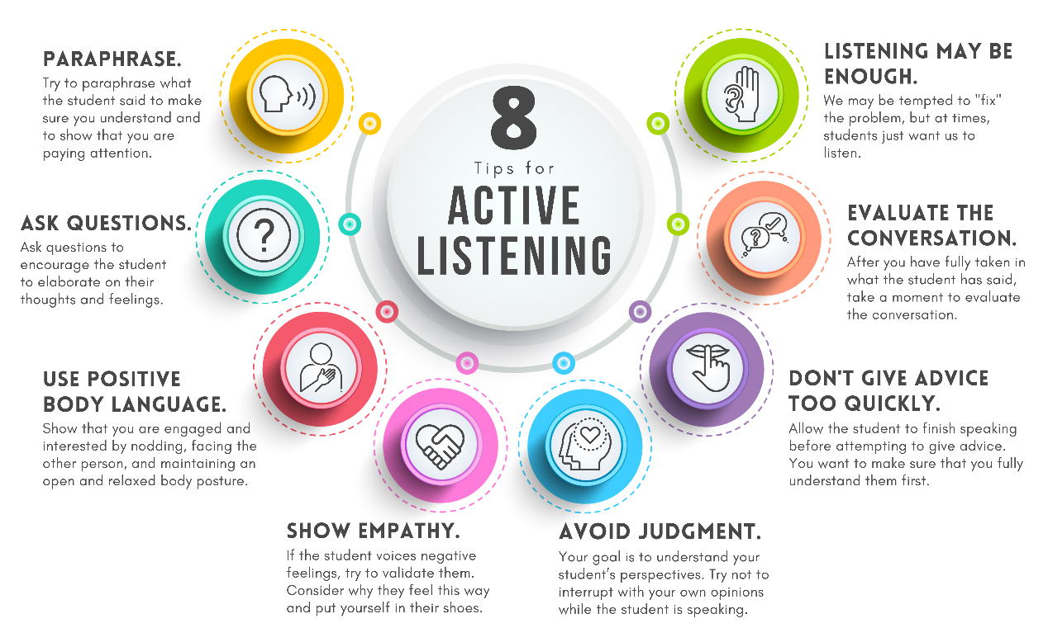
A few application ‘tips’ in teaching

Slide 13
How can we confront a Verbal Assault?
EMPLOYEE/COLLEAGUE: “Victims like me have to work even on Saturdays, while you're absent watching football games! Who do you think you are? You're taking a double salary, and you only think about yourself.”.
What would you reply to this verbal assault?
  “Don't be negative. Working on weekends when necessary is explicitly mentioned in your contract. If you didn't notice it, now is a good opportunity to read it more carefully. Oh, and I forgot to mention that your raise has already been arranged for next month!” or
  “I understand… So, I guess I’ll need to find someone else to work overtime.”
Source: Payne, 2001

Slide 14

Verbal Assault-Solution
None reply is correct!!
What you should do:
  Try asking a question. Questions force others to think, whereas they may instinctively just want to react.
  If you ignore the assaults and continue to ask questions, the anger will often subside.
  In the first response, even if you're right, you'll fall into the other person's trap. Your reaction will be emotional, and the result will likely be a heated argument with no winner.
  In the second response, the other person may stop shouting, but it sends the message that shouting loudly will get him/her what he/she wants.

Slide 15
Instructions of experiential workshop(1/5)
(Πηγή: Bateman & Snell, 2017)
In each group, each member gets a number 1, 2, or 3 (e.g. according to the alphabetical order of the member's first name e.g. 1=Anna, 2=George, 3=Maria). In the 1st round: 1 takes the PROS position, 2 takes the CONS position, and 3 acts as an OBSERVER (who keeps time and notes). The duration of each round is set to 15’.
Suggested list of topics for conversation (You can also discuss a topic of your own choice):
  1.The existence of guns at home
  2. Death penalty for convicts
  3. Interracial baby adoption
  4. Legalization of marijuana
  5. Compulsory conscription into the armed forces
  6. Internet Pornography
Group members takes 1’ to select the topic of discussion.
1st round (1=CONS, 2=OBSERVER, 3=PROS):
Selected topic: _______________________________________________________________
Observer’s notes: ____________________________________________________________

Slide 16
Instructions of experiential workshop 1st Round (2/5)
While the OBSERVER (3) writes the subject, the PROS (1) and CONS (2) members have 1’ to think about their point of view and then they have 5'-7’ to reach a mutually acceptable solution.
The OBSERVER keeps the time and records actual examples of what the ‘conflicted parties’ have said or acted, based on a list of active and less active behaviors given in Table 1.
After the time has passed, the PROS and CONS members share their feedback on which behaviors they performed well and which need improvement.
The OBSERVER presents his own noted observations and experiences about how the PROS and CONS members performed their active listening practice.

Slide 17
Instructions of experiential workshop (3/5)
Table 1. Information about Listening
Indications of Active Listening
1. Asked questions for clarification
2. Paraphrased the opposite view
3. Reacted to non-verbal cues (body language, vocal tone)
4. Worked towards a mutually acceptable solution
Indication of Less Active Listening
1. Interrupted his interlocutor instead of letting him finish
2. Became defensive about his/her position
3. Tried to dominate the conversation
4. Ignored non-verbal cues

Slide 18
Instructions of experiential workshop(4/5)
Then, if possible, 2 further rounds are followed discussing each time a different topic, so that everybody would act all the roles. The roles are changed cyclically until everyone has gone through all the roles
2nd round (1=CONS, 2=OBSERVER, 3=PROS):
Selected topic: _______________________________________________________________
Observer’s notes: _______________________________________________________________
_____________________________________________________________________________
3rd round (1=OBSERVER, 2=PROS, 3=CONS):
Selected topic: _______________________________________________________________
Observer’s notes: _______________________________________________________________
_____________________________________________________________________________
You have 45’ to complete the 3 rounds (at least 2 completes rounds). Then everybody will return to the main room to discuss some questions. All groups exchange their experiences and answer specific questions.

Slide 19
Questions asked in the plenary session (5/5)
How did you come to a mutually acceptable solution? What helped you get there?
Which factors hindered this process?
How comfortable did you feel supporting the PROS or CONS position? How did this affect your active listening ability?
If the given position (PROS vs. CONS) was opposed to your values, did you see the issue from a different perspective before the workshop?
What steps could you take to improve your ability to listen actively to your friends or collaborators, especially if you disagree with their opinions?

Slide 20
Sum up and Evaluation
The workshop concludes with a discussion on how to further cultivate active listening.
To deepen participants' learning and evaluate their experience, a short anonymous questionnaire (e.g. via Google Forms) can be shared.

Slide 21
Βιβλιογραφία
Bateman & Snell (2017). Διοίκηση Επιχειρήσεων, 11η έκδοση, Εκδόσεις Τζιόλα.
Caudill, D. W. and Donaldson, R. M. (1986). Effective Listening Tips for Managers. Administrative Management, September, pp 22-33.
Ferrari, B. (2012). The executive’s guide to better listening. McKinsey Quarterly, February 2012. http://dln.jaipuria.ac.in:8080/jspui/bitstream/123456789/3102/1/The%20executives%20guide%20to%20better%20listening.pdf
Hersey, P., Blanchard, K. H., Johnson D. E. (2001). Management of Organizational Behavior. Leading Human Resources, (8th Ed.) Prentice Hall, New Jersey.
Nieman, G. and Bennett, A. (2002). Business management. A value chain approach. Van Schaik Publishers.
Payne J. & Payne S. (2001). Management: How to do it, Gower Publishing Limited.
Seibert, H. J. (1990). Listening in the Organizational Context, Listening Behavior: Measurement and Application, ed. R. N. Bostrom, New York: The Guilford Press, pp 119-127.

